Slide 1


Company Network Report Wake Futbol Club
Created by: Team 3
Team Members: Justin Eimers, Jacob Smith, Toni Coleman, Collin Ryan, Tamara Gonzalez
Tamara G Villarroel

Slide 2


Overview
Wake Futbol Club: A Community-Driven Soccer Haven
Established in 2012 in Holly Springs, NC.
Provides enriching soccer experiences for residents of Wake County and beyond.
Non-profit organization dedicated to breaking barriers.
Focus on community-building and fostering relationships.
Collin Ryan

Slide 3
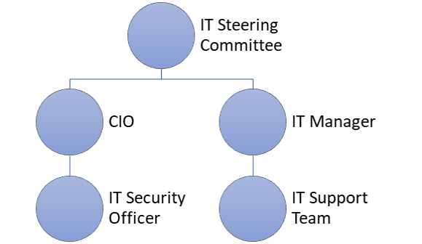
IT Governance and Structure Diagram
IT Steering Committee:
Aligns IT strategy with organizational goals.
Comprises leaders from both IT and non-IT departments.
Responsibilities include strategic planning, resource allocation, risk management, and project oversight.
Chief Information Officer (CIO):
Senior executive overseeing IT department.
Ensures IT initiatives align with organization's objectives.
Responsibilities encompass IT leadership, technology evaluation, budget management, and security oversight.
IT Manager:
Manages day-to-day IT operations.
Responsible for team management, infrastructure oversight, vendor relationships, and user support.
IT Security Officer:
Focuses on implementing and maintaining security measures.
Manages security policies, incident response, staff training, and regulatory compliance.
Tamara Villarroel

Slide 4
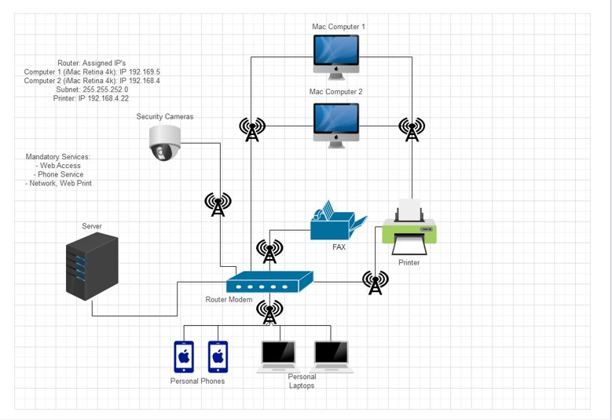
Logical Network and Diagram
Components:
Two desktop computers directly connected to the main router modem.
Main router connecting to the ISP via Wi-Fi.
IP Addressing:
Utilized Bitwise AND operation involving the iMac Retina 4K 1's IP address and subnet mask.
Connection Details:
Clear representation of device connections and IP addressing scheme.
Jacob Smith

Slide 5
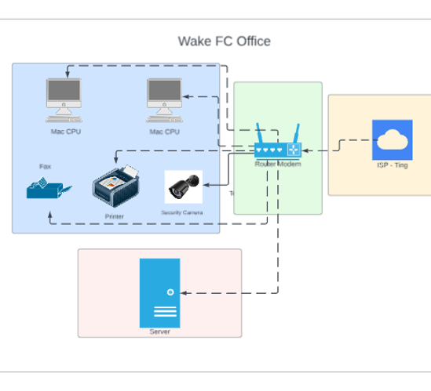
Enterprise Architecture and Diagram
Location and Infrastructure:
Operates within a trailer office.
Core devices include a server, modem router, computers, fax machine, and printer.
Firewall and Security:
External firewall controls and routes data traffic.
Provides password-protected wireless access for authorized users.
Upcoming Upgrade:
Proposal to upgrade firewall for increased bandwidth speeds.
Jacob Smith

Slide 6

Needs Assessment
Wake FC's Objectives:
Player registration & content management
Enhance network infrastructure
Stakeholder Analysis:
Key stakeholders: Board Members, Players, Coaches, Volunteers, IT support, Parents
Goals & Objectives:
Improve online presence
User-friendly website
Methodology & Process:
Data collection strategies
Ethical considerations, budgeting, timeline, details plans
Constant evaluation and feedback
Toni Coleman
Notes:
Script: Our needs assessment is designed to identify the deliverables essential for the successful execution of these enhancements. Key stakeholders include: Board Members, Players, Coaches, Volunteers, Parents, Families, Web Developers, and IT Support, each contributing with specific responsibilities and interests. These goals are geared towards enhancing the club's online visibility, simplifying player registration processes, and strengthening communication channels. Our approach will include diverse data collection methods, target populations, and instrument development. Furthermore, ethical considerations, budget requirements, and a detailed timeline ensure a comprehensive and transparent process. This approach extends to a communication plan, ongoing evaluation, and feedback mechanisms (such as surveys), contributing to a dynamic and innovative website. This will ensure a transformative and transparent approach to elevating Wake FC's digital landscape.

Slide 7
Risk Assessment
Single Server Dependency:
Introduce redundancy measures (backup servers, cloud-based solutions)
Regular backup data to prevent loss
Develop a disaster recovery plan
Competition from Other Sports Clubs:
Monitor competitor's online presence
Regular updates of website features (user surveys)
Develop a disaster recovery plan
Cyber Threats:
Cybersecurity measures
Security audits & updates
Employee training on cybersecurity best practices
Limited Budget:
External funding opportunities
Infrastructure upgrades
Cost-effective solutions & partnerships
Toni Coleman
Notes:
Script: We have identified key challenges & risks encompassing cybersecurity threats, financial constraints, single server dependence, competition, limited office space, performance issues, and data privacy concerns. To address the ever-present threat of cyber-attacks, we prioritize implementing cybersecurity measures, conducting regular security audits & updates, and ensuring thorough employee training. Financial limitations are countered by actively seeking external funding, prioritizing critical infrastructure upgrades, and exploring cost-effective solutions & partnerships. Single server vulnerability is mitigated through redundancy measures, including backup servers & cloud-based solutions, along with a comprehensive disaster recovery plan. Competing with other clubs involves continuous monitoring, regular website updates based on user feedback, and a disaster recovery plan. Limited physical office space is being managed by evaluating expansion options, optimizing the current layout, and exploring remote work possibilities. Performance issues are tackled through infrastructure assessments, equipment upgrades, increased bandwidth, and regular monitoring. Finally, data privacy and compliance are ensured by regularly reviewing and updating privacy policies, implementing consent mechanisms, and staying informed about data protection laws. These proactive mitigation strategies collectively work to safeguard Wake FC against potential risks and challenges.

Slide 8
Gap Analysis
Gap Analysis:
Project Management Tools Gap: Current tools lack advanced project tracking features.
Communication Gap: Reliance on email slows down communication and hampers collaboration.
Resource Allocation Gap: Manual assignment leads to uneven workloads and delays.
Documentation Gap: Limited documentation impacts knowledge transfer and onboarding.
Action Plan:
Upgrade Project Management Tools: Research and implement a robust project management tool.
Communication Platform: Introduce a real-time messaging platform for team communication.
Automate Resource Allocation: Invest in a resource management system for automated task assignment.
Documentation System: Implement a knowledge-sharing platform and encourage documentation.
Jacob Smith

Slide 9

S.W.O.T Analysis
Justin Eimers
Strengths:
Non-profit organization collaborating closely with the community.
Utilizes a cloud-based web server, ensuring accessibility and scalability.
Weaknesses:
Faces limitations on potential growth opportunities.
Relies on a single server; its failure could lead to significant downtime.
Opportunities:
Can enhance online presence through social media platforms.
Potential for expansion into larger office spaces as the organization grows.
Threats:
Faces cybersecurity threats that could compromise sensitive data.
Deals with limited budgets, impacting the ability to maintain and enhance the network.

Slide 10
Recommendations
Supply Chain Risks:
Recommendation: Diversify suppliers, assess vulnerabilities.
Mitigation: Establish alternatives, maintain communication.
Reputation Risks:
Recommendation: Proactively manage reputation.
Mitigation: Implement crisis plan, respond to feedback, prioritize ethics.
Human Resource Risks:
Recommendation: Address HR challenges.
Mitigation: Invest in training, establish clear policies, foster positive culture.
Strategic Risks:
Recommendation: Reassess and adapt business strategy.
Mitigation: Establish planning process, monitor indicators, remain agile.
Environmental and Social Risks:
Recommendation: Assess impact on environment and society.
Mitigation: Implement sustainable practices, contribute to social causes, communicate efforts.
Legal Risks:
Recommendation: Regularly review and update legal policies.
Mitigation: Consult experts, establish legal review process, stay informed.
Market Risks:
Recommendation: Conduct market analysis.
Mitigation: Diversify, stay updated, and be flexible.
Financial Risks:
Recommendation: Assess financial health.
Mitigation: Establish budgeting, maintain funds, explore partnerships.
Operational Risks:
Recommendation: Evaluate and enhance operations.
Mitigation: Implement contingency plans, invest in tech, train employees.
Cybersecurity Risks:
Recommendation: Fortify cybersecurity measures.
Mitigation: Invest in tools, educate employees.
Compliance Risks:
Recommendation: Stay informed about regulations.
Mitigation: Establish compliance team, conduct audits, train employees.
Jacob Smith

Slide 11
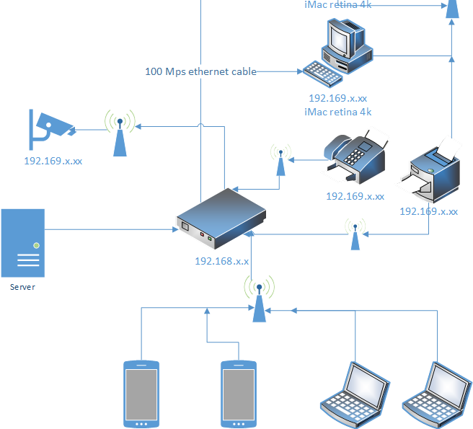
Network Diagram
Jacob Smith

Slide 12

Disaster recovery and security plan
Wake FC relies on a cloud server but lacks protection.
Urgent need for a disaster recovery plan.
Recommend partnering with Backblaze for data backup.
Backblaze offers fixed prices, unlimited storage, and easy setup.
Retains file versions for specific points in time.
Ideal for soccer club's seasonal data retrieval.
Strong security measures, including encryption and two-factor authentication.
Overall, Backblaze is the best choice for ensuring data safety.
Justin Eimers

Slide 13
Migration Planning
Assess
Plan
Prep
Test
Migrate
Launch
Collin Ryan

Slide 14
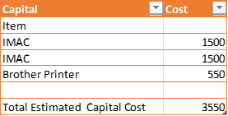
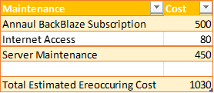
Detailed Budget
This budget is for upgrading current tech on site with newer equipment
Justin Eimers

Slide 15

Conclusion
Strategic Roadmap:
Comprehensive plan for website enhancement and infrastructure improvement.
Focus on optimizing user experiences, improving communication, and fortifying security measures.
Prioritizes strategic technology upgrades for sustained success.
Budget Considerations:
Prudent investment in upgrading technology.
Allocations for new iMacs, security cameras, printer, and cloud-based backup solution.
Disaster Recovery Plan:
Collaboration with Backblaze for robust cloud-based backup.
Ensures data security, easy transition, and restoration to specific points in time.
Conclusion:
Wake FC poised for sustained success and continued community impact.
Backed by a resilient digital strategy and strategic investments.
Prepared for potential challenges with a robust disaster recovery framework.
Tamara G Villarroel

